Slide 1


Cybersecurity & Ethical Hacking Fundamentals
CLASS 01
Information security, hacker types, core terms, the CIA Triad and security principles.
Notes:
Welcome. Five lessons and one lab today.

Slide 2





What we will cover
TODAY
01 · Information security
02 · Types & hackers
03 · Core terms
04 · CIA Triad
05 · Principles
Vulnerability and exploit
Threat and attack
Risk
Confidentiality
Integrity
Availability
Least privilege
Defence in depth
Zero trust and models
What it is
How it differs from cybersecurity
Why it matters
Types of cybersecurity
White, black and grey hats
Ethical hacking process
HackToLive Academy · Class 01 · Overview
2 / 19
Notes:
Overview of the five lessons, then the lab.

Slide 3

What is information security?
LESSON 01 · INFORMATION SECURITY
Information
Security
Goal
Any data that has value
Paper, digital or spoken
Examples: IDs, bank records, source code, business plans
Protecting information from misuse
Stops unauthorized access, change and loss
Covers people, process and technology
Keep information Confidential, accurate and available
Known as the CIA Triad
Covered in Lesson 04
HackToLive Academy · Class 01 · Lesson 01
3 / 19
Notes:
Information can be physical or digital.

Slide 4
Information security vs cybersecurity
LESSON 01 · CYBERSECURITY
Aspect | Information security | Cybersecurity
Scope | All information, in any form | Digital systems, networks and data
Protects | Paper files, people, devices, data | Computers, apps, networks, cloud
Example | Locked cabinet, shredding papers | Firewall, antivirus, MFA
Relationship | The bigger umbrella | A part of information security
Cybersecurity is one part of information security.
HackToLive Academy · Class 01 · Lesson 01
4 / 19
Notes:
Diary in a drawer vs password on a phone.

Slide 5



Why security matters
LESSON 01 · WHY IT MATTERS
Money
Privacy
Trust
Operations
Fraud and theft
Ransom payments
Costly downtime
Personal data exposed
Identity theft
Legal penalties
Customers leave after a breach
Reputation is slow to rebuild
Partners ask for proof of security
Hospitals, banks and power need uptime
Attacks can stop services
Safety can be at risk
HackToLive Academy · Class 01 · Lesson 01
5 / 19
Notes:
Impact examples, keep it general.

Slide 6



Five areas of cybersecurity
LESSON 02 · TYPES OF CYBERSECURITY
Network
Application
Cloud
Endpoint
Information
Protects connections
Firewall, IDS/IPS, VPN
Stops unwanted traffic
Protects apps and websites
Secure coding, testing
Regular patching
Protects online services
Access rules, encryption
Safe configuration
Protects laptops and phones
Antivirus, EDR
Device updates
Protects the data itself
Encryption, backups
Data classification
HackToLive Academy · Class 01 · Lesson 02
6 / 19
Notes:
Each area protects a different asset.

Slide 7

Three kinds of hackers
LESSON 02 · TYPES OF HACKERS
White hat
Black hat
Grey hat
Has written permission
Goal: find and fix weaknesses
Also called an ethical hacker
Legal and professional
No permission
Goal: money, damage or data
Criminal activity
Examples: ransomware gangs, fraudsters
No permission, no clear bad intent
May report what they find
Still breaks the law
Not an accepted practice
HackToLive Academy · Class 01 · Lesson 02
7 / 19
Notes:
Permission is the line between ethical and illegal.

Slide 8






How an ethical test works
LESSON 02 · ETHICAL HACKING
Permission
Scope
Test
Report
Retest
Written approval from the owner
Agree what can be tested and when
Find weaknesses safely
Explain findings and fixes
Confirm the fixes work
Ethical hacking always needs written permission.
HackToLive Academy · Class 01 · Lesson 02
8 / 19
Notes:
Stress the legal side.

Slide 9



Five terms, one house
LESSON 03 · CORE TERMS
Vulnerability
Exploit
Threat
Risk
Attack
A weakness
Example: a broken lock
A way to use the weakness
Example: a lockpick
Something that can cause harm
Example: a burglar nearby
Chance of harm and its impact
Example: likely robbery, valuable items
Harm actually happening
Example: the break-in
HackToLive Academy · Class 01 · Lesson 03
9 / 19
Notes:
House analogy.

Slide 10





From weakness to impact
LESSON 03 · HOW THEY CONNECT
Vulnerability
Threat
Exploit
Attack
Impact
A flaw exists in a system
Someone or something can use it
A method to use the flaw
The method is carried out
Data lost, service down, money lost
Fix vulnerabilities early to break the chain.
HackToLive Academy · Class 01 · Lesson 03
10 / 19
Notes:
Walk left to right.

Slide 11
Understanding risk
LESSON 03 · RISK
Scenario | Likelihood | Impact | Risk
Admin account with a weak password | High | High | Critical
Public web server missing a patch | High | High | High
Old printer on an isolated network | Low | Low | Low
Lost USB drive with encrypted files | Medium | Low | Low
Risk = Likelihood × Impact. Handle it: reduce, accept, transfer or avoid.
HackToLive Academy · Class 01 · Lesson 03
11 / 19
Notes:
Fix the highest risks first.

Slide 12
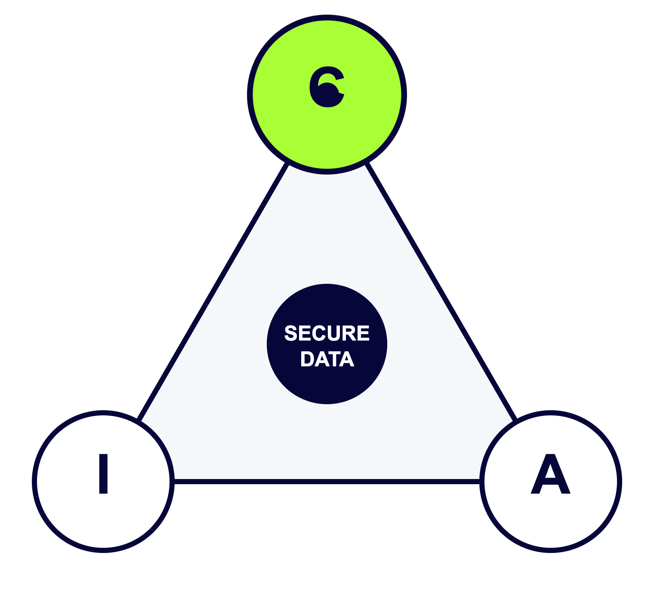
The three pillars of security
LESSON 04 · CIA TRIAD
C · Confidentiality
Only authorized people can see the data.
I · Integrity
Data stays accurate and unchanged.
A · Availability
Systems and data work when needed.
HackToLive Academy · Class 01 · Lesson 04
12 / 19
Notes:
Ask of any incident: which pillar was hit?

Slide 13
Controls for each pillar
LESSON 04 · CIA IN PRACTICE
Pillar | Protects against | Common controls
Confidentiality | Data theft, snooping | Encryption, MFA, access control
Integrity | Tampering, mistakes | Hashing, digital signatures, audit logs
Availability | Outages, DDoS, ransomware | Backups, redundancy, patching, recovery plan
HackToLive Academy · Class 01 · Lesson 04
13 / 19
Notes:
Controls map to pillars.

Slide 14
Which pillar is affected?
LESSON 04 · PRACTICE
Scenario | Pillar
Customer database is stolen | Confidentiality
Someone changes an invoice amount | Integrity
A website goes down during a DDoS attack | Availability
Ransomware locks all company files | Availability
Payroll file emailed to the wrong person | Confidentiality
HackToLive Academy · Class 01 · Lesson 04
14 / 19
Notes:
Let students answer before revealing.

Slide 15

Principles that reduce damage
LESSON 05 · CORE PRINCIPLES
Least privilege
Separation of duties
Need to know
Fail-safe defaults
Give only the access needed
Limits damage from a hacked account
Review access regularly
Split critical tasks between people
No single person can misuse a process
Example: one requests, another approves
Access depends on job role
Even trusted staff see only what they need
Supports confidentiality
Deny access by default
Allow only what is approved
Safer when things break
HackToLive Academy · Class 01 · Lesson 05
15 / 19
Notes:
Link each to CIA.

Slide 16
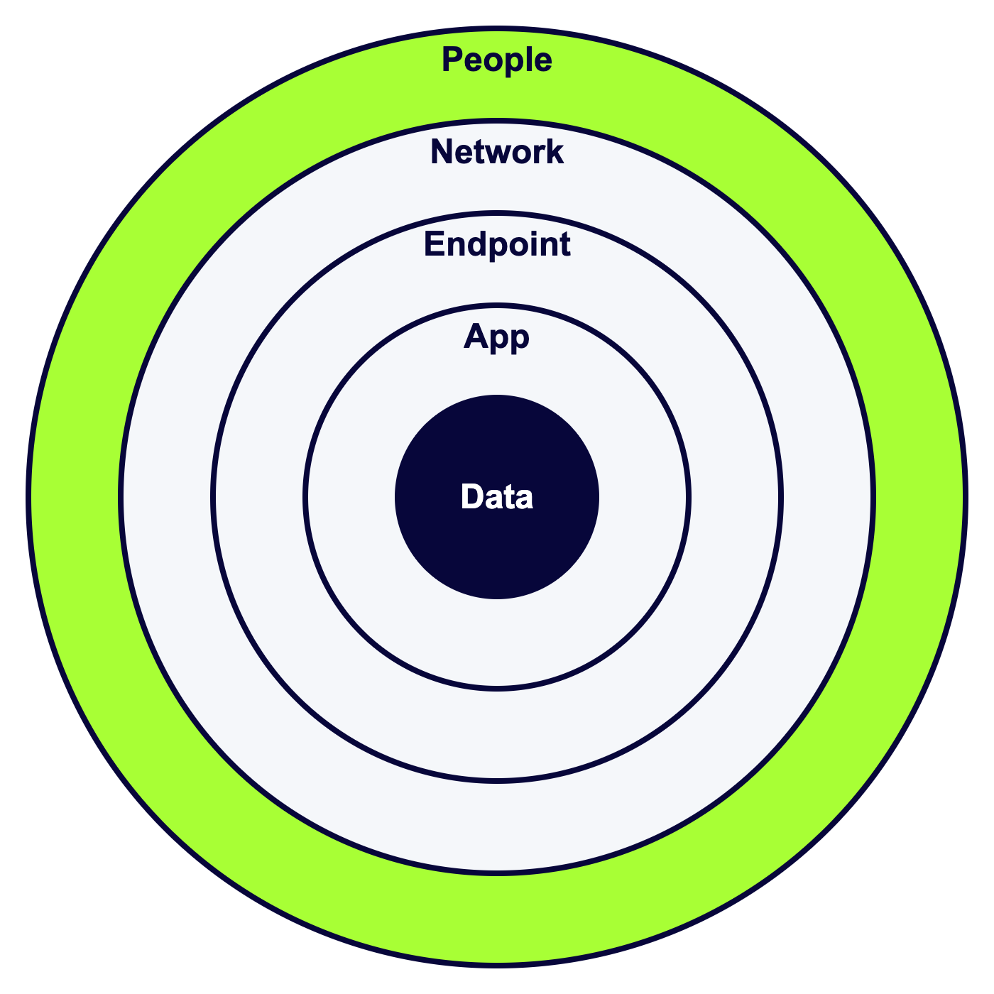
Many layers, not one wall
LESSON 05 · DEFENCE IN DEPTH
Think of a castle
Moat, walls, gate and guards each add protection
If one layer fails, the next still stops the attacker
Layers: people, network, endpoint, application, data
Mix of preventive, detective and recovery controls
Example: firewall + MFA + antivirus + backups + training
HackToLive Academy · Class 01 · Lesson 05
16 / 19
Notes:
Rings glow from outside to inside.

Slide 17
Never trust, always verify
LESSON 05 · ZERO TRUST & MODELS
Zero trust
Bell-LaPadula
Biba
No device or user is trusted by default
Verify every request
Assume the network may already be breached
Protects confidentiality
No read up, no write down
Used in government and military
Protects integrity
No read down, no write up
Keeps trusted data clean
HackToLive Academy · Class 01 · Lesson 05
17 / 19
Notes:
Models are rules for information flow.

Slide 18
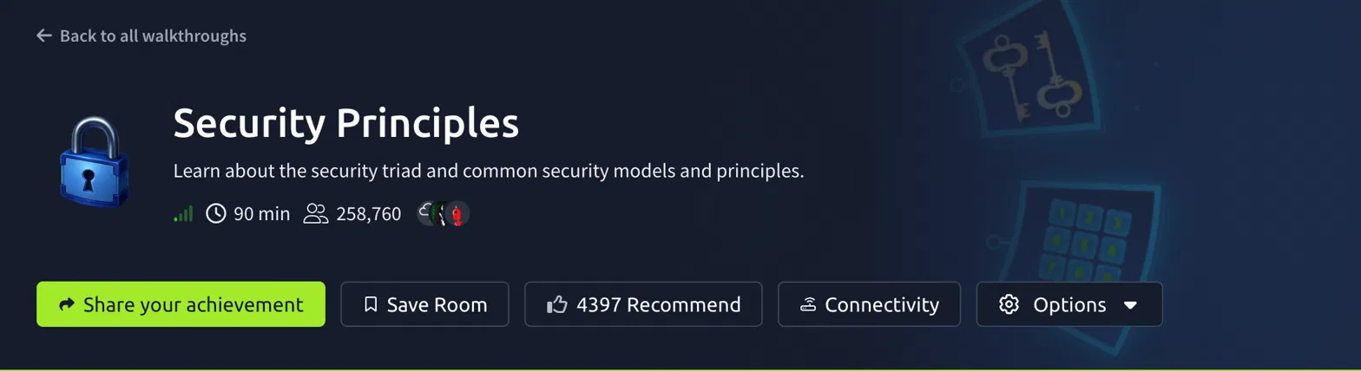
TryHackMe: Security Principles
HANDS-ON LAB
Steps
Create a free TryHackMe account
Open the room link
Click Join Room
Read each task carefully
Answer the questions
Take notes in your own words
tryhackme.com/room/securityprinciples
About 90 minutes. Covers the security triad and common models and principles from today.
HackToLive Academy · Class 01 · Hands-on lab
18 / 19
Notes:
Show how to join the room.

Slide 19


Key takeaways
RECAP
Remember
Practice
Homework
Cybersecurity is part of information security
White hat means permission
Vulnerability, threat, exploit, attack, risk
CIA: Confidentiality, Integrity, Availability
Finish the TryHackMe room
Write notes in your own words
Note questions for next class
Pick an app you use daily
Give one example each for C, I and A
Name one control for each
HackToLive Academy · Class 01 · Recap
19 / 19
Notes:
Close the class.

